Slide 1
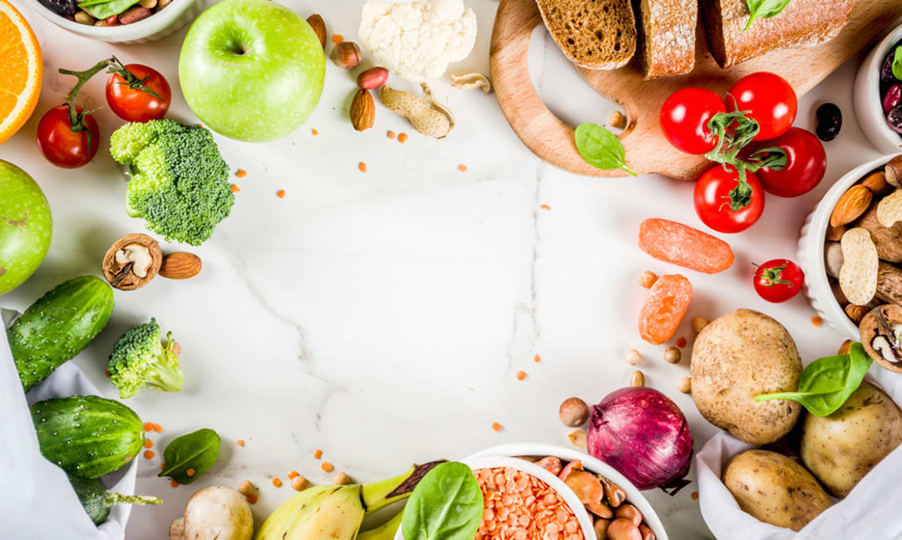
Ingredients - Recipe Converter
APAN5400 Managing Data Group Project
Presented by Group 4:
Jiarong Zhang
Weiyi Xia
Shuning Xu
Shiyun Hua
Zeying Liu

Slide 2
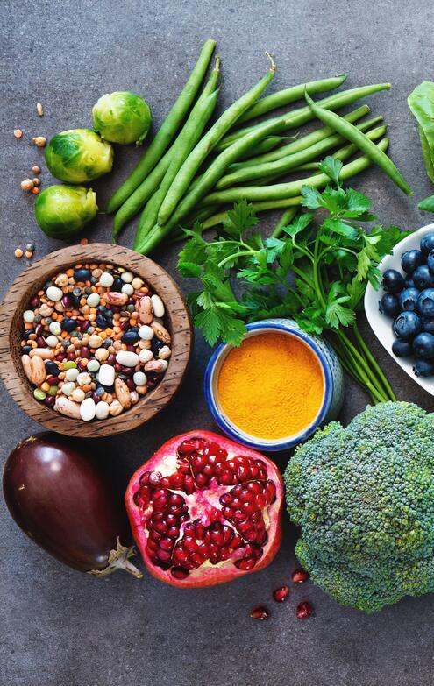
Background & Definition of the Recipe Search Engine
01
02
Data Source and Procurement
03
Design Choices & Rationales for Selected Techniques
04
Performance Visualization
Applicable Data Quality Dimensions, Licensing, Scalability & Cost Implications
05
Conclusions & Future Recommendations
06

Slide 3






01
Background & Definition of the Recipe Search Engine
Ingredients - Recipe Converter / Meal Planner
Analysis
Rating Comparison
Nutrient composition distribution
Goals
Time Control
Plan, cook and share meals
Discover healthy and economical eating habits
Reduce food wastage
Target
People who have lots of ingredients in the refrigerator but can’t decide what to do today
People who don’t know the formal name of specific dishes but only have some ingredients
People who need to eliminate all ingredients left in the refrigerator ASAP
People who have fitness or fat loss goals and pay attention to balanced nutrition
Competitive advantages
Omission of menu names
Ingredient Elimination
Innovative Recipe Provision

Slide 4


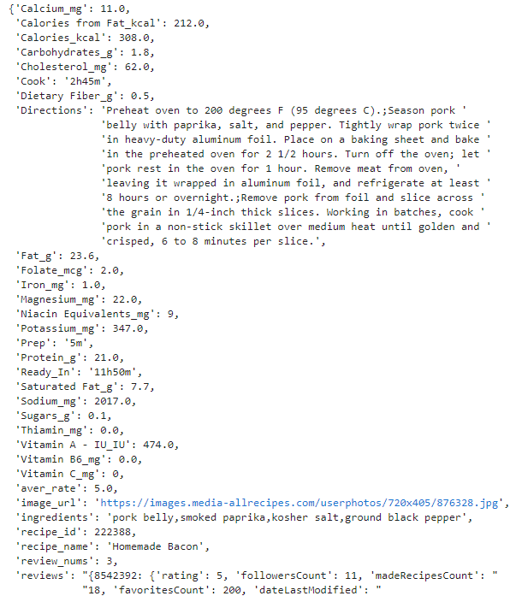
02
Data Source and Procurement
Source | Allrecipe.com
Access | Web crawling
Format | JSON (after process)
Size | 1.64 GB
 | 49698 records
Details | Contain recipes posted between 2000 and 2018, including recipe name, ingredients, image, cooking directions, nutrition info, and ratings.
Source: kaggle https://www.kaggle.com/datasets/elisaxxygao/foodrecsysv1

Slide 5








03
Design choices & rationales for selected techniques
Why Elasticsearch
Why Flask
Why Neo4j
1. Multi-tenancy can be easily handled
2. Distributed document-oriented that makes easy to scale up in large organization
3. Good for analyzing free-text and unstructured data
4. Support for advanced full text search features
Search engines based on web pages as output results
2. Flexible components
3. Easy interaction with the database
4. Suitable for rapid website construction
1.Powerful and expressive query language and require less code than SQL
2. It is very easy to represent semi-structured data
3.Retrieving/traversing/navigating more connected data is convenient and fast
4. Scalability and high availability optimized for graphs
Front End
(Client Side)
Back End
(Server Side)
Server
Client
Database

Slide 6
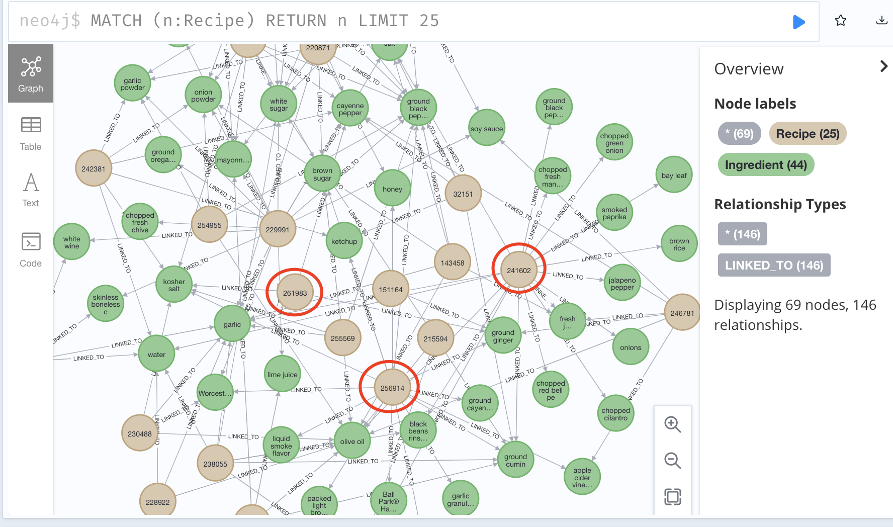
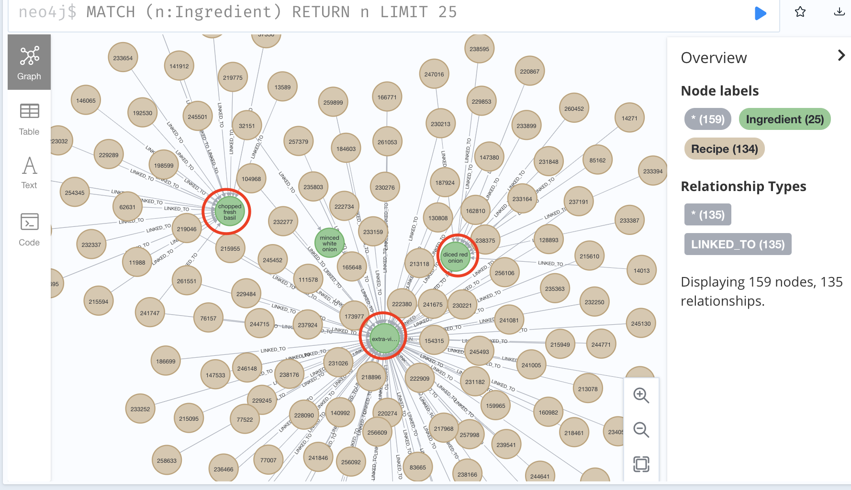
04-1
Process and results demonstration
Recipe - Ingredients
The relationship between ingredients and recipes

Slide 7
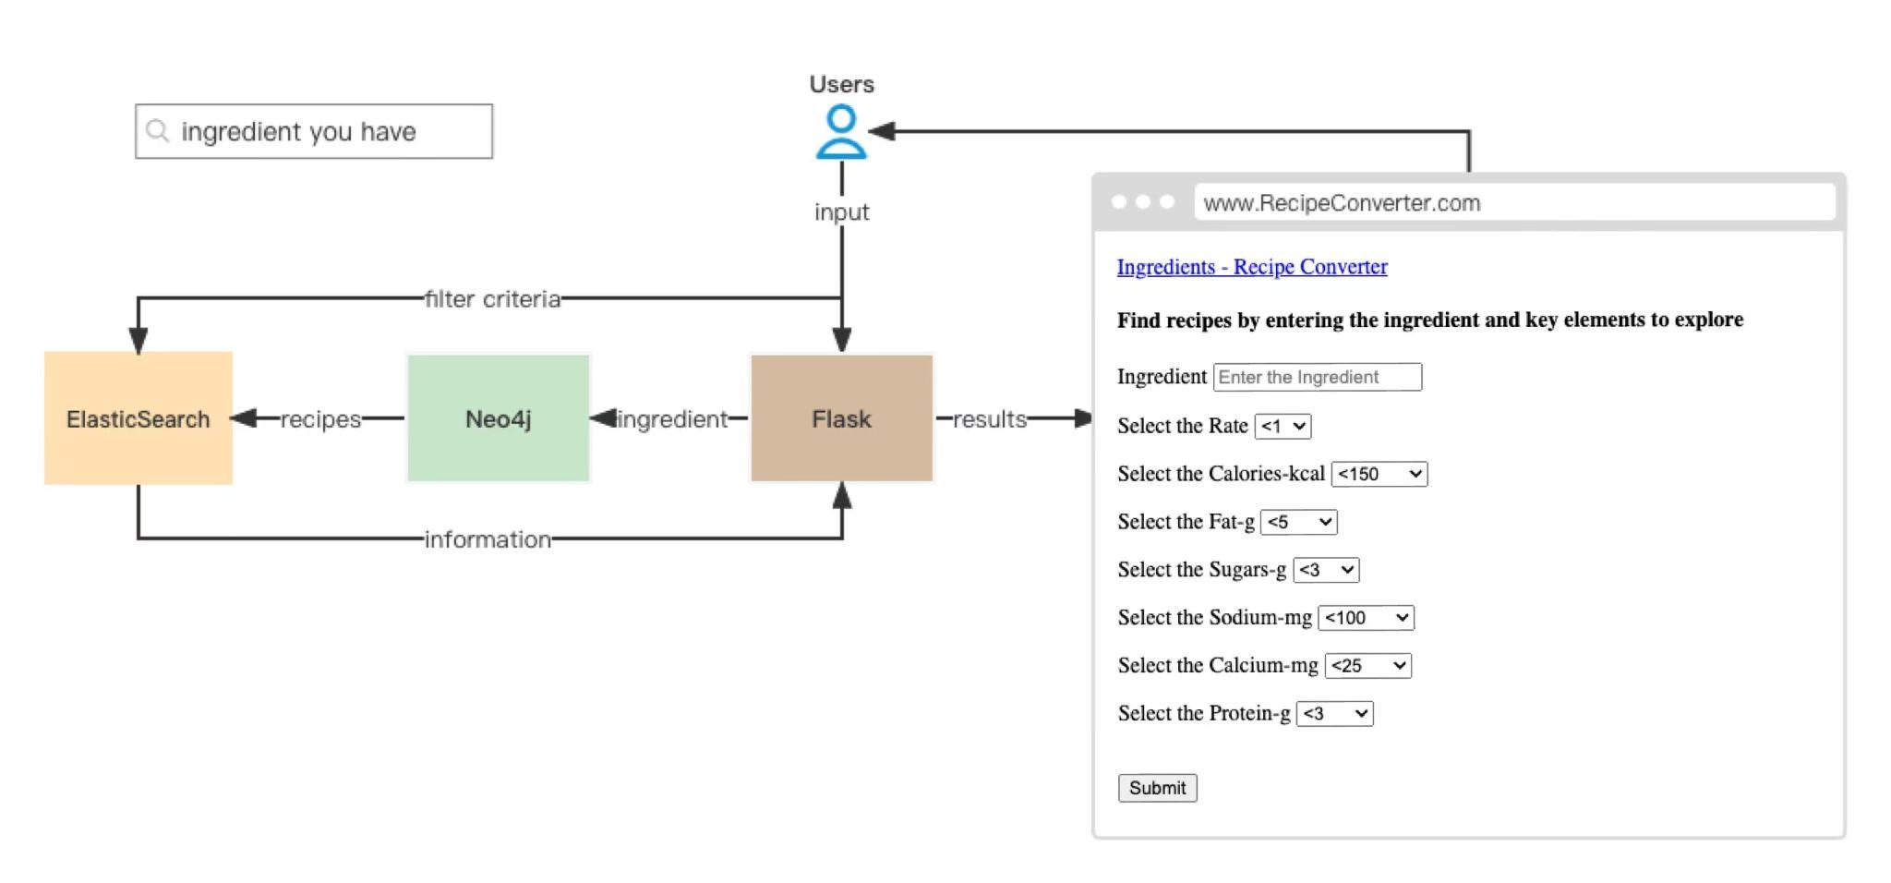
04-2
Process and results demonstration

Slide 8
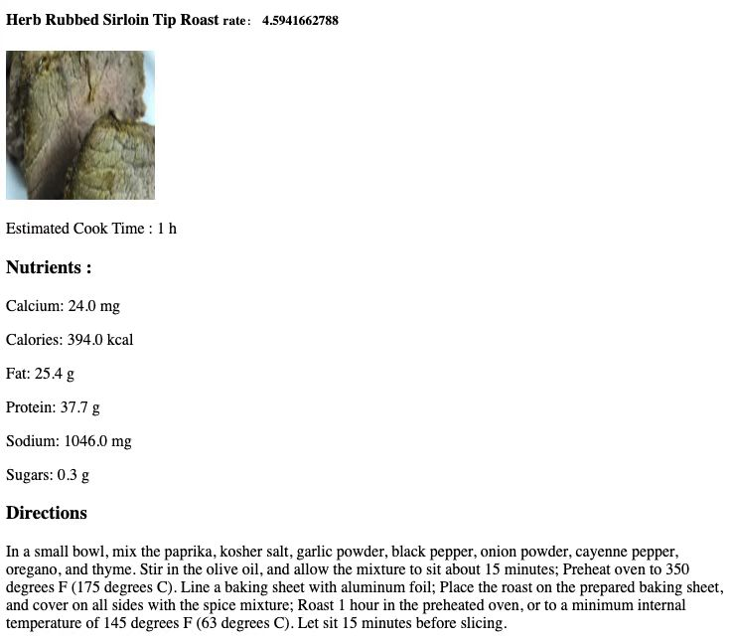


04-3
Process and results demonstration
Recipe Example

Slide 9

05-1
Applicable data quality dimensions
Accuracy, Timeliness
The source of recipes are posted by members of the Allrecipes.com community in real time and then copyedited by staff. Members of the community also rate and review the recipes.
Completeness
Our dataset include but not limited to recipe name, ingredients, cooking directions, cook time, nutritions, rate, review and images, which fulfills customers' demand for recipe and expectations of completeness.
Consistency
No information conflicts
Validity
Our recipe information follows its specific format and business rules.
Uniqueness
No data duplication in our dataset.
Understandability
Our dataset is easily comprehended.

Slide 10
05-2
Licensing, Scalability & Cost Implications
Scalability
Cost implications
Neo4j :
High-performance distributed cluster architecture
Native graph Processing: millions of hops per second
Scalability and high Availability
Elasticsearch:
Distributed and easy to scale out to handle massive amounts of data
Our project does not rely on any resource that charges an extra fee for now
When dataset scales up in the future (i.e. over 10 GB):
Elasticsearch as a service: $20/month
Cloud Neo4j graph database service: $64.8/month
Licensing
Creative Commons
CC BY

Slide 11



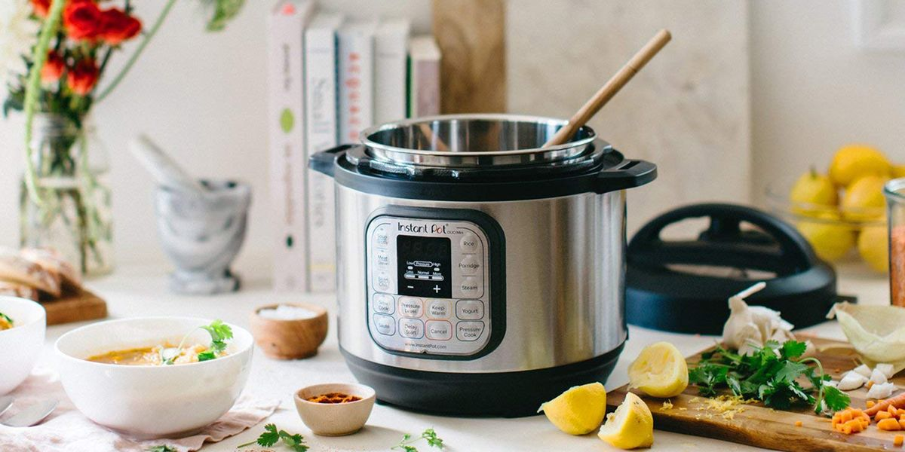

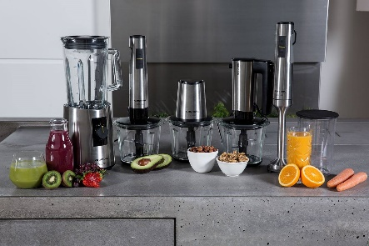




06
Conclusions & Future Recommendations
01
Conclusion
Our team aims to create a recipe search engine that can efficiently help users find targeted recipes when they have specific needs. We acquire recipe information from the allrecipes website. According to our comprehensive assessment, we apply neo4j, elasticsearch as back end database and flask to present the web page as front end.
02
Future Recommendations
In the future we aim to refine and segment the web framework to provide users with more options, such as cooking times for each step, as well as options to optimize the combination of nutrient content.Furthermore, we will expand the number of recipes in our database, commercialize our model, and collaborate with automated cooking appliance companies, health care companies, etc. to create new business loops for future growth.

